Slide 1
Puzzlebot Gazebo Simulator
Instructions manual

Slide 2
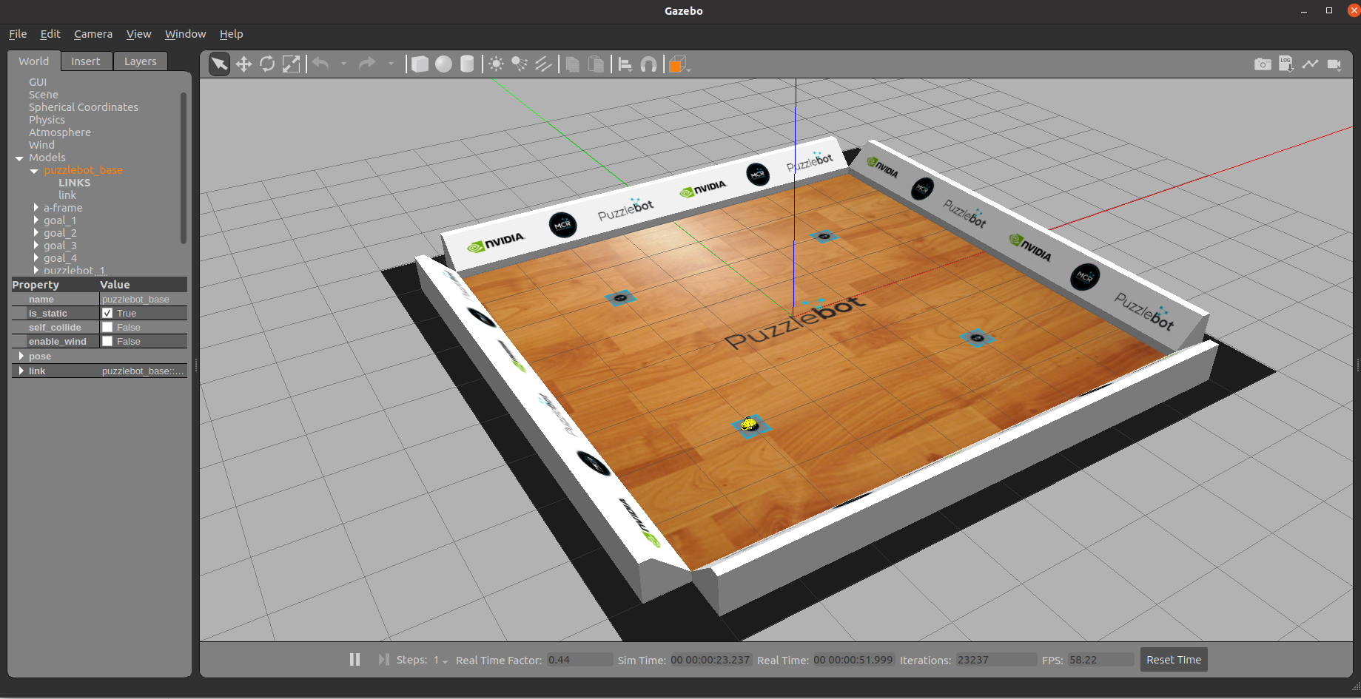
Gazebo simulation
Initialising the simulation
Download the ROS packages to your workspace source folder (e.g., catkin_ws/src)
Build and source the packages
Run the Puzzlebot gazebo simulator using the following command
The following screen should appear
puzzlebot_gazebo
puzzlebot_control
puzzlebot_description
$ roslaunch puzzlebot_gazebo puzzlebot_gazebo.launch
$ cd ~/catkin_ws/
$ catkin_make
$ source devel/setup.bash

Slide 3
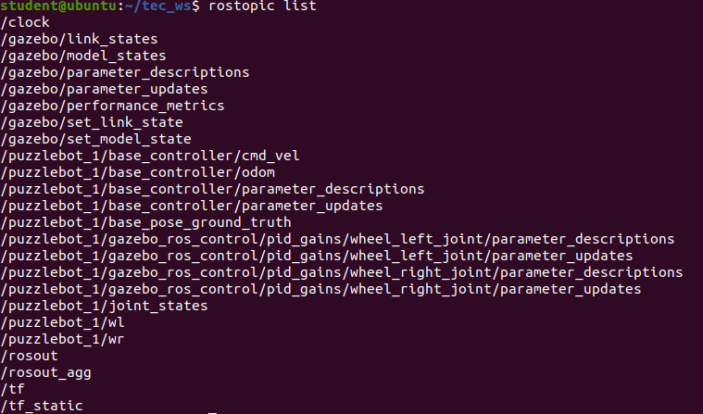
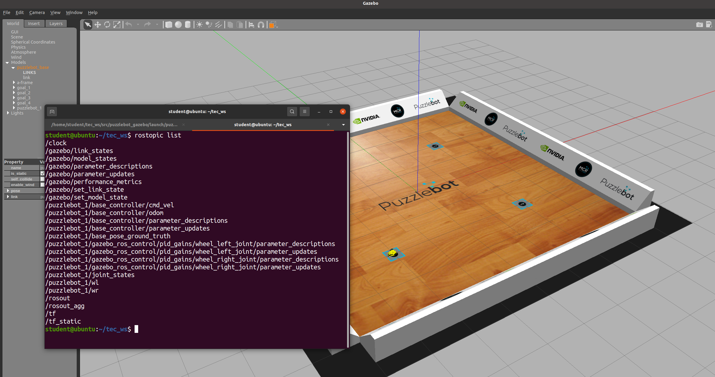
Gazebo simulation
Initialising the simulation
Open another terminal
Verify the topics generated by the simulator using the following command
The following list of topics should appear
$ rostopic list

Slide 4
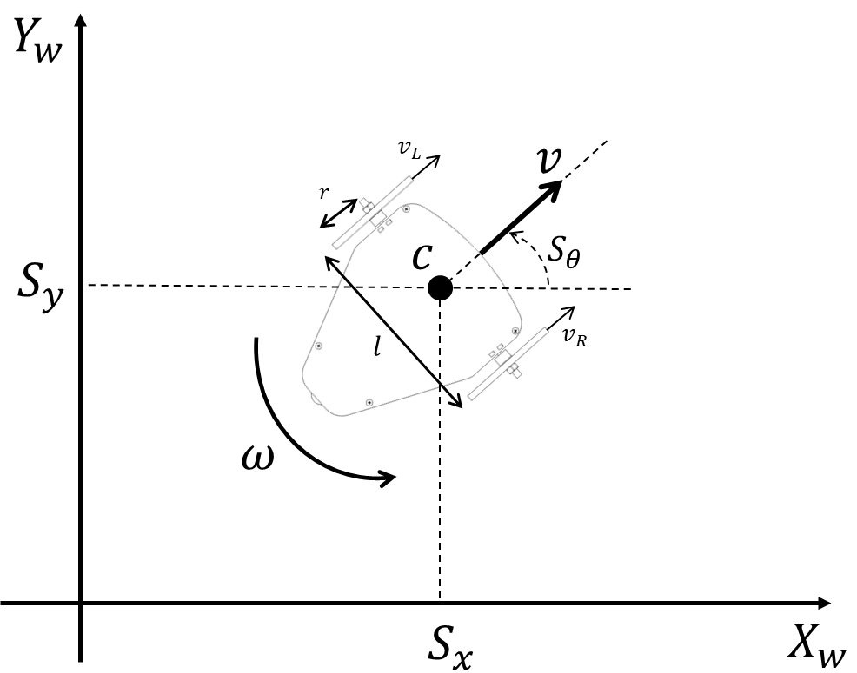

Gazebo simulation
Running the simulation
Sending velocity commands to the robot is done using the following topic
The message to be used is a geometry_msg/Twist (more information here)
The robot’s linear velocity $v$ and angular velocity $ω$ must be set in the linear.x and angular.z sections of the message (ROS convention for differential drive robots).
/puzzlebot_1/base_controller/cmd_vel
Topic: /puzzlebot_1/base_controller/cmd_vel
Message: geometry_msgs/Twist
"linear:
x: linear_velocity (v)
y: 0.0
z: 0.0
angular:
x: 0.0
y: 0.0
z: angular_velocity (omega)"

Slide 5

Gazebo simulation
Running the simulation
To publish a message to the gazebo-simulated robot from the terminal can be done as follows.
The previous command will make the robot to run in a circle.
$ rostopic pub -r 10 /puzzlebot_1/base_controller/cmd_vel geometry_msgs/Twist "linear:
x: 0.3
y: 0.0
z: 0.0
angular:
x: 0.0
y: 0.0
z: 0.3"

Slide 6
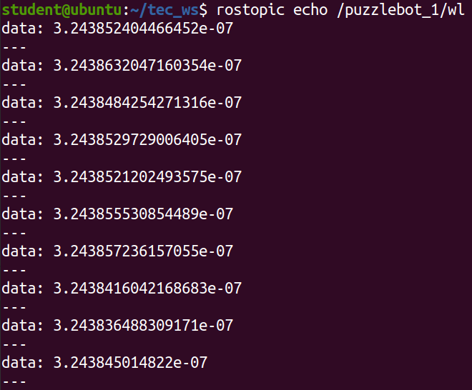
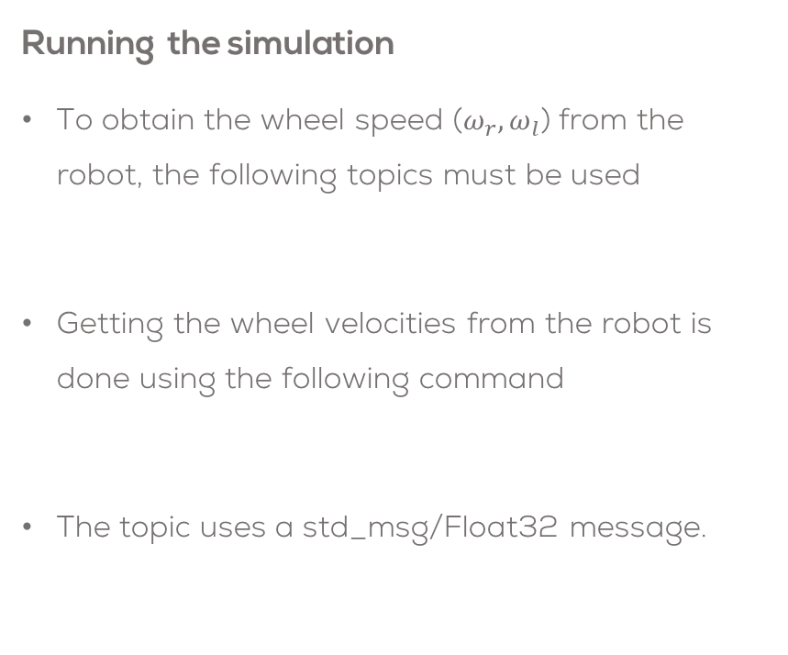
Gazebo simulation
Running the simulation
To obtain the wheel speed ($ω_{r}, ω_{l}$) from the robot, the following topics must be used
Getting the wheel velocities from the robot is done using the following command
The topic uses a std_msg/Float32 message.
/puzzlebot_1/wr
/puzzlebot_1/wl
$ rostopic echo /puzzlebot_1/wl
Topic: /puzzlebot_1/wl
Message: std_msgs/Float32

Slide 7
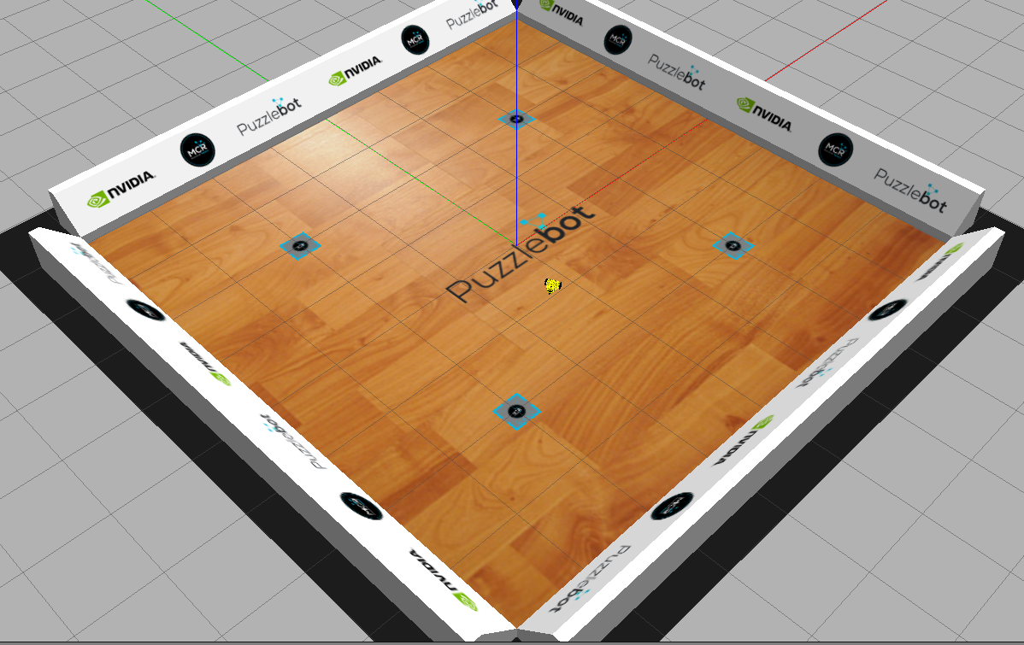
Robot Teleoperation
Install the teleoperation package
Run the gazebo simulator as described before
In another terminal, run the teleoperation node as follows
Control the robot using the keyboard (i, j, l, k) as described on the terminal.
sudo apt install ros-noetic-teleop-twist-keyboard
$ roslaunch puzzlebot_gazebo puzzlebot_gazebo.launch
rosrun teleop_twist_keyboard teleop_twist_keyboard.py _repeat_rate:=10 cmd_vel:=puzzlebot_1/base_controller/cmd_vel _speed:=0.4 _turn:=1.1

